Slide 1
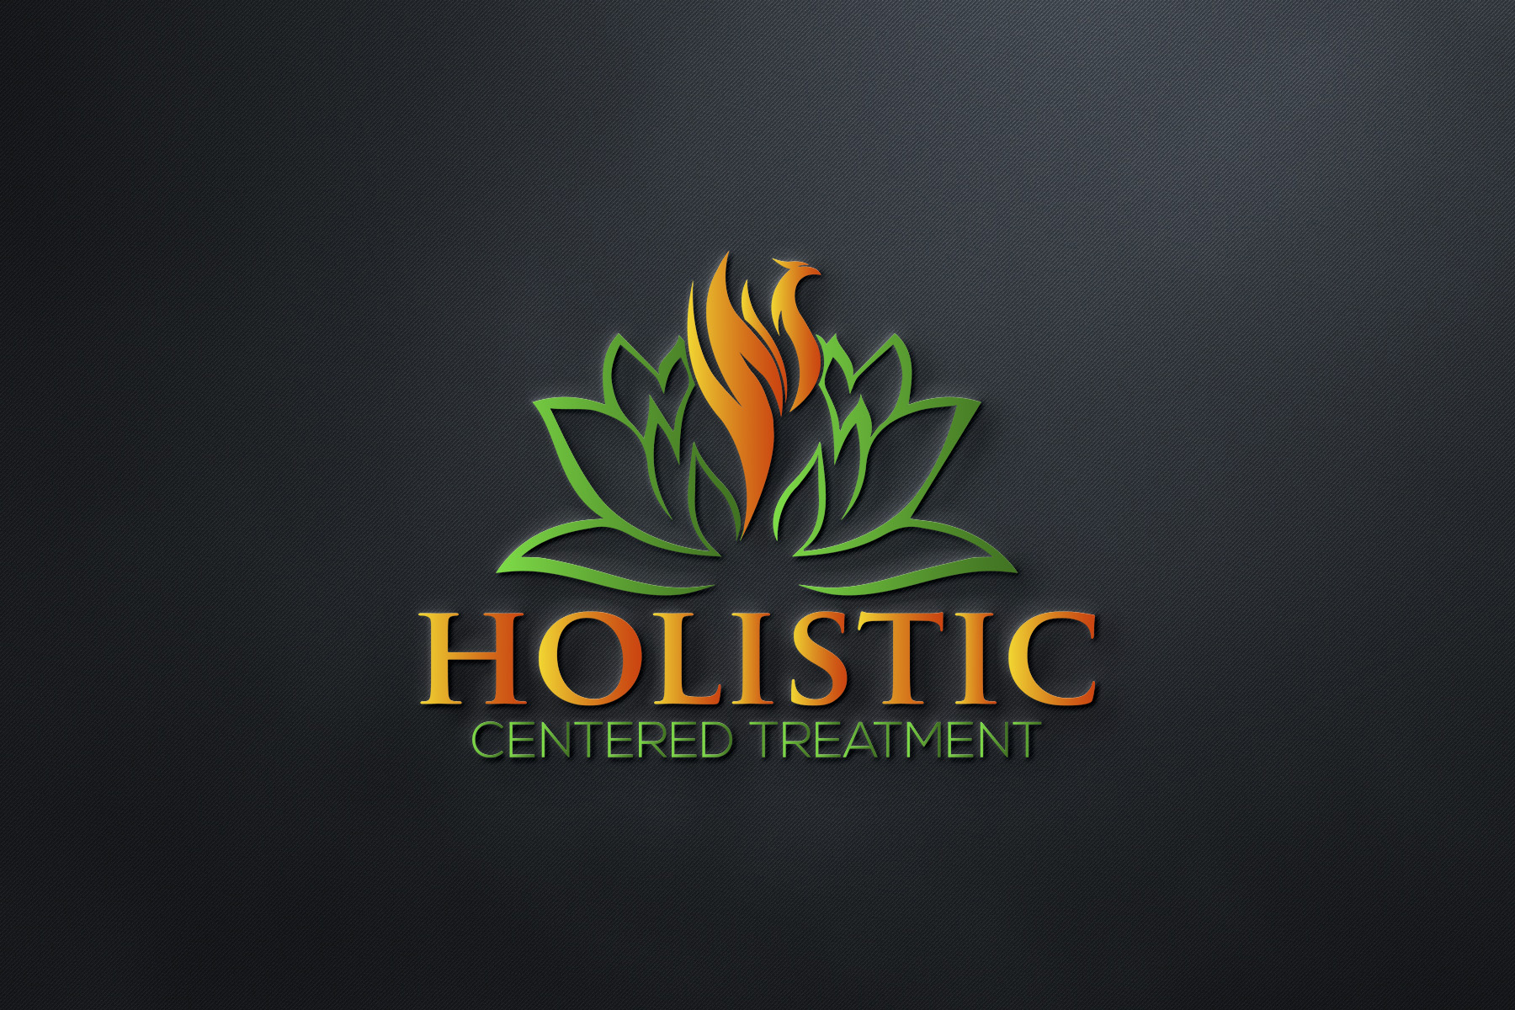
Complex Regional Pain Syndrome in Children
How to Help Your Children Overcome
Dr. Traci Patterson
CRPS Survivor
President, Holistic Centered Treatment

Slide 2
Dr. Traci Patterson
CRPS Survivor
CRPS Expert
President, Holistic Centered Treatment
Creator, CRPS Hub
CRPS Advocate
Published Author

Slide 3
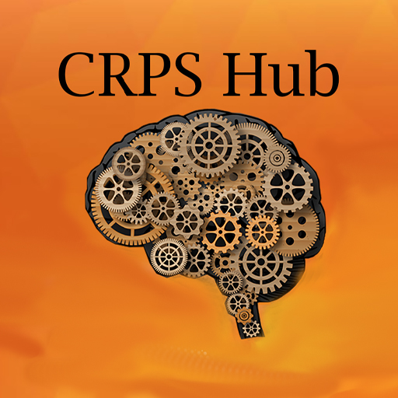
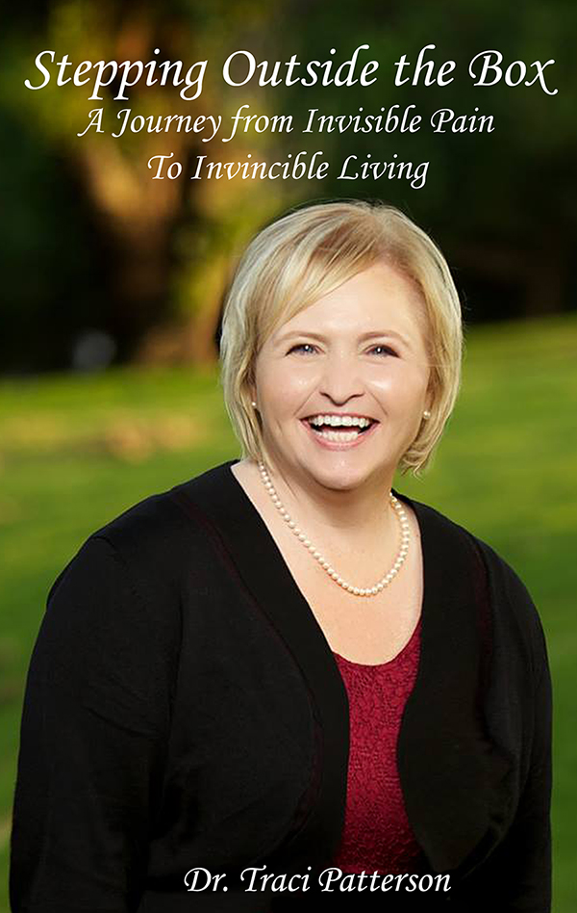

Slide 4
Pain, Sensitivity & CRPS
Pain is a normal human experience.
Without the ability to experience pain – we wouldn’t survive.
Living in pain, however, is not normal.
Pain Can be frightening and intimidating.

Slide 5
Pain, Sensitivity & CRPS Continued…
In some people, this pain, can be so severe that areas of the body become extra sensitive to:
Touch
Pressure
Clothing
Movement
Air Temperature
and more…
Imagine someone touching you with a feather – only to have it feel light a blow torch. That is how CRPS can feel.

Slide 6
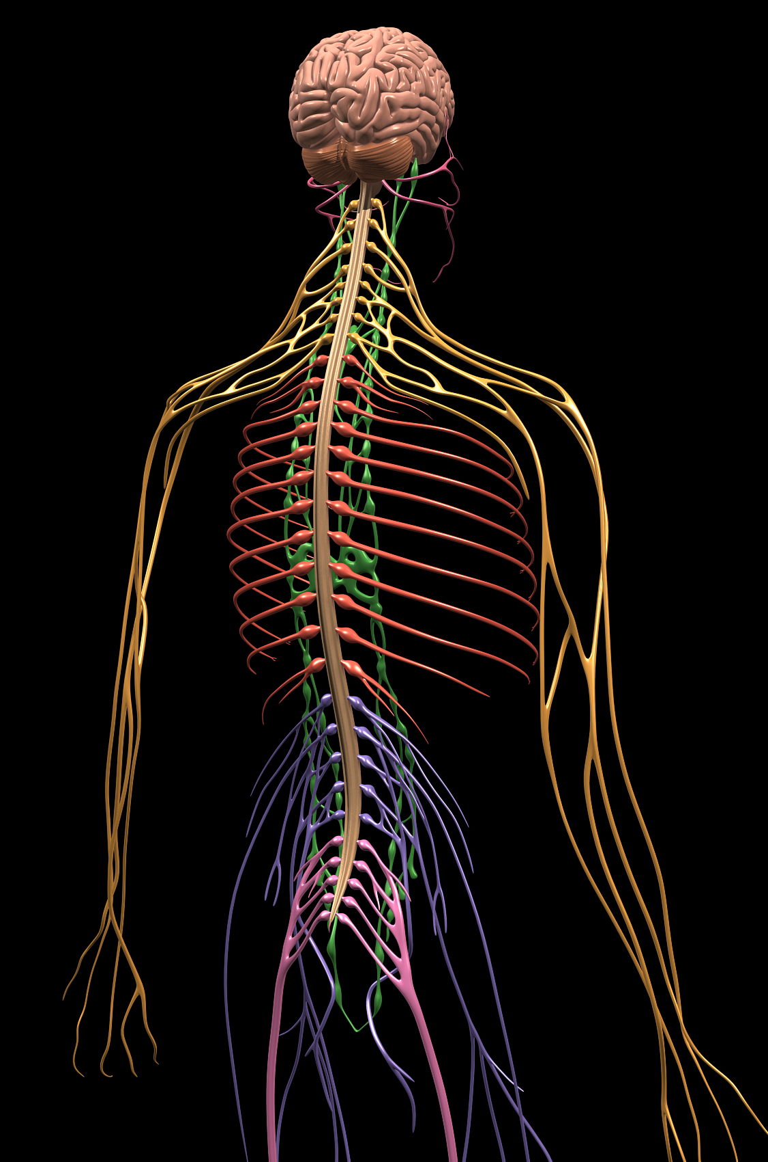
Knowledge of How Pain Works
In the last 10-15 years, our knowledge of how pain works has increased considerably.
Focus has shifted away from just muscles, ligaments and joints.
We now know the brain and nervous system are main contributors to pain.
This is for all pain – regardless of where it is in the body.

Slide 7
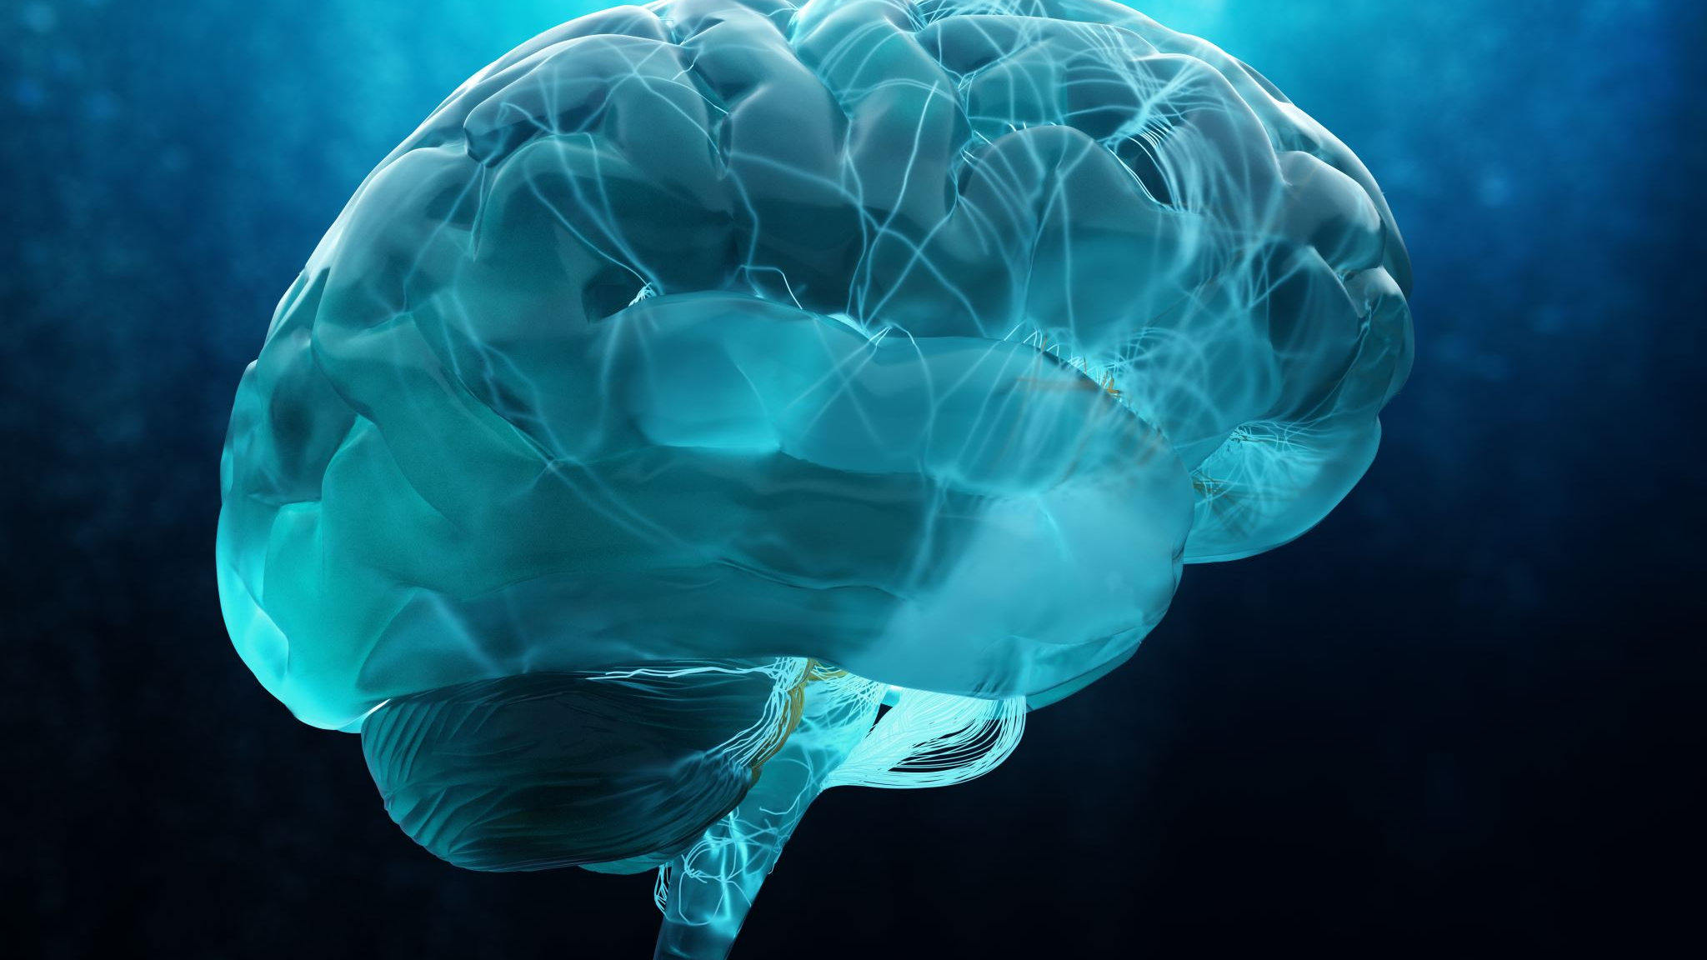
Common Mistakes When Dealing With Pain
Too much emphasis put on tissues or muscles.
Typical strains, sprains and even surgical sites heal in 6-8 weeks.
It’s important to know that ongoing pain is:
Pain that lasts longer than the normal healing period.
It is more likely due to sensitive nerves and how the brain processes information from the body.
Understanding these simple facts is a great jumping off point. The latest research shows that the more you know about pain and how it works, the better off you’ll be.
Remember – Knowledge is Power

Slide 8
CRPS - RSD
An Important Topic – YOUR LABEL
Many people are given a long label of:
Complex Regional Pain Syndrome (CRPS)
This term came about in 1996 when scientists and doctors changed it from Reflex Sympathetic Dystrophy (RSD) to CRPS.
Which one does your child have?
It DOES NOT MATTER.
It signifies one thing – Your child is hurting, and you need answers and help.
Both are treated the same.
Is it Type 1 or Type 2 CPRS?
Type 1 is no known nerve damage or nerve involvement.
Type 2 is known nerve involvement or damage

Slide 9
CRPS The Perfect Storm
Think of the perfect storm in the brain.
CRPS occurs when the nervous system and the immune system malfunction as they respond to an injury or tissue damage.
There is an inciting event, injury or surgery.
Many times, there is also a high level of stress around the time.
Most of the time the individual also had a drop in their immune system around this time.
Thus, creating the perfect storm in the brain = CRPS

Slide 10
CRPS Basics
CRPS stands for Complex Regional Pain Syndrome.
It is a condition where the Central Nervous System becomes sensitized.
People with CRPS experience a wide range of symptoms and there is no easy, one size fits all, treatment for CRPS.
CRPS is not a new or very rare disease. It was first diagnosed in the US during the Civil War in the 1850s.

Slide 11
CRPS Basics continued…
CRPS is also known as Reflex Sympathetic Dystrophy (RSD)
And was previously called Causalgia as well.
There are also some doctors that will diagnose Reflex Neurovascular Dystrophy (RND).
In some cases, Amplified Musculoskeletal Pain Syndrome (AMPS) may also be used, although this is not always synonymous with CRPS.

Slide 12
About a Quarter of Children with Amplified Pain Have CRPS.
It can occur in more than one body area.
Some children with CRPS have spreading pain that includes areas without overt autonomic dysfunction but still with extreme amplified pain.
It can even involve their entire body.
It is a misnomer to say that they have total body CRPS since they do not have the overt autonomic dysfunction all over.
This is a typical example of how the various forms of amplified pain can overlap.

Slide 13
CRPS and Ehlers-Danlos Syndrome
There are some children diagnosed with Ehlers-Danlos Syndrome (EDS) that are also diagnosed with CRPS.
It is hypothesized that EDS might contribute to the development of CRPS in one or more of the following ways:
Via stretch injury to nerves traversing hypermobile joints
Increased fragility of nerve connective tissue
Or nerve trauma from more frequent surgeries

Slide 14
What is Ehlers-Danlos Syndrome (EDS)? Ehlers-Danlos Syndrome (EDS) is not a disease.
It is a connective tissue disorder or syndrome.
Connective tissue is made of collagen. In someone with EDS:
• The connective tissue is weak.
• It stretches easily.
• It breaks easily.
• It does not heal well.
Two important things to remember:
1. Weak connective tissue
2. Poor joint position sense (proprioception)

Slide 15
When children do not meet the definition of CRPS they fall into a category of localized amplified pain.
There are many children who have pain similar to CRPS in a localized part of their body but there are no associated signs of autonomic dysfunction.
Some of these children have localized pain to their limbs, like those who have CRPS, or they can have localized pain to their trunk, scalp, or virtually any part of their body.

Slide 16
Other Co-Existing Conditions
The longer the duration with CRPS – the more dominoes can fall.
Autonomic Dysfunction
A condition in which the nerves of the autonomic nervous system are damaged or not functioning correctly. This can affect the heart function, blood pressure, bladder function, digestion, etc.
Postural Orthostatic Tachycardia Syndrome (POTS)
A condition where the heart rate increases on changing the posture, such as lying to sitting up or standing. This will cause dizziness or fainting.
*Although I’m not saying these will occur.

Slide 17
Living with CRPS
Can feel lonely.
Help your child get connected with other kids. Find activities they can do.

Slide 18
Let's Learn About Pain
In your body – every human body…
There are over 400 individual nerves!
Think about 45 miles of nerves traveling through the body and connecting all the body parts – like highways.

Slide 19
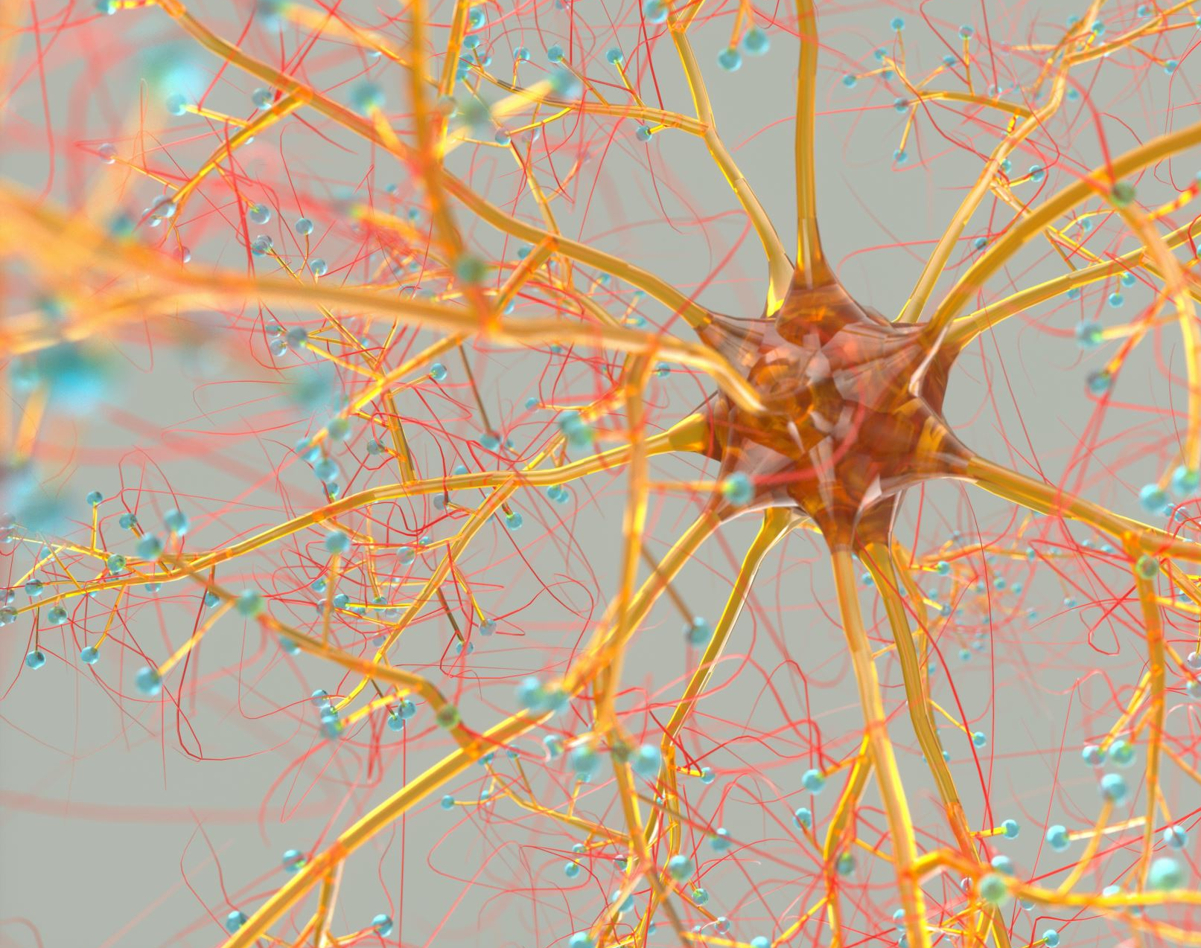
Your Body’s Alarm System
Nerves work like an alarm system.
At all times – nerves have a small amount of electricity traveling through them.
The nerve’s activity increases or decreases depending on many factors.
Stress
Anxiety
Fears
Movement
Temperature

Slide 20
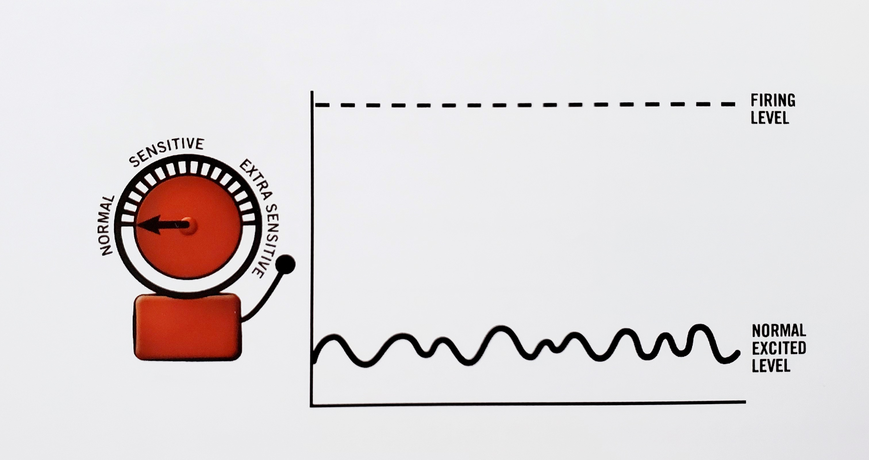
The Alarm System and Pain
Although nerves are affected by many factors – they do have thresholds.
When nerves become excited enough to reach the threshold – the message is sent to the brain for analysis and an appropriate action.
As soon as the alarm goes off and sends the message, the alarm system is supposed to return to its resting level.

Slide 21
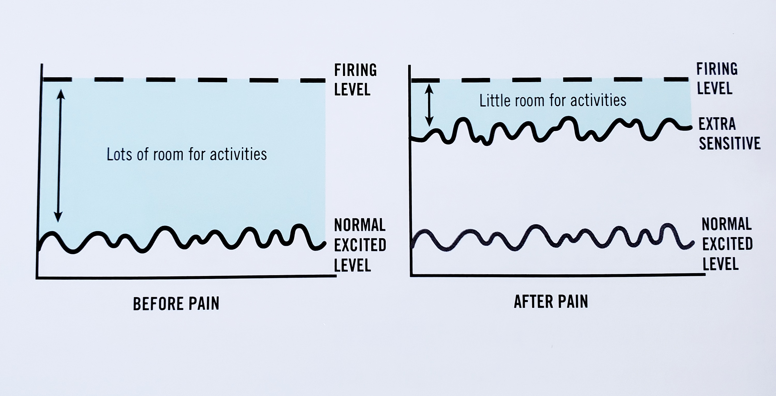
The Alarm System and CRPS
When the nerves are extra sensitive – which happens with CRPS – there is less room prior to hitting the ‘firing level’ of the nerves.
Following a diagnosis of CRPS you may notice a small amount of stress, pressure or activities now set off the nerves. Increasing pain.
The main issues are:
Increased nerve sensitivity
Fight/flight also drives this
Your alarm system has become extra sensitive

Slide 22
‘Fight or Flight’ and CRPS
The autonomic nervous system (ANS) is the part of our nervous system that controls functions of the body which are not consciously controlled, such as heart rate, breathing and digestion.
The sympathetic nervous system (SNS) is part of the ANS, and its main function is to activate the changes necessary for a perceived harmful event, commonly referred to as our ‘fight or flight’ response.
One theory suggests that following physical trauma, CRPS may develop as a result of the SNS triggering the release of certain ‘fight-or-flight’ hormones known as catecholamines.

Slide 23
Fight or Flight
When the sympathetic nervous system (SNS) is activated in what is commonly known as the “fight or flight” response, the hormones and neurotransmitters of adrenaline (also called epinephrine) and noradrenaline (also called norepinephrine) are released. This response is triggered by physical or mental stress.
When our body is stuck in this state it then can cause vasomotor changes, coloration changes, temperature changes, edema, etc. And, in the long-term it can cause a dysregulation in the immune system.
Keep in mind that the brain is ultimately in control of the body.
The bottom line is:
Fight or Flight is the driver of CRPS and many other pain conditions.
To address CRPS you must address Fight or Flight.
Simply treating the symptoms does not work!

Slide 24
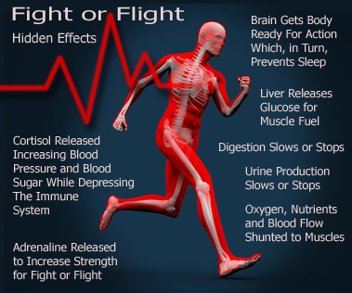
Stop the Fight or Flight Response
The first step to addressing CRPS is to address ‘Fight or Flight’.
When we can get the body out of Fight or Flight - then we can calm down the sympathetic overload.
This allows us to start balance the autonomic system which plays a key role in our overall health.

Slide 25
When we can get the individual out of fight or flight - then it starts balancing out the Autonomic Nervous System (ANS).
Our body cannot heal when it is not balanced or in homeostasis.
Balancing the ANS will automatically drop pain levels.
This in turn allows the body to start healing.

Slide 26
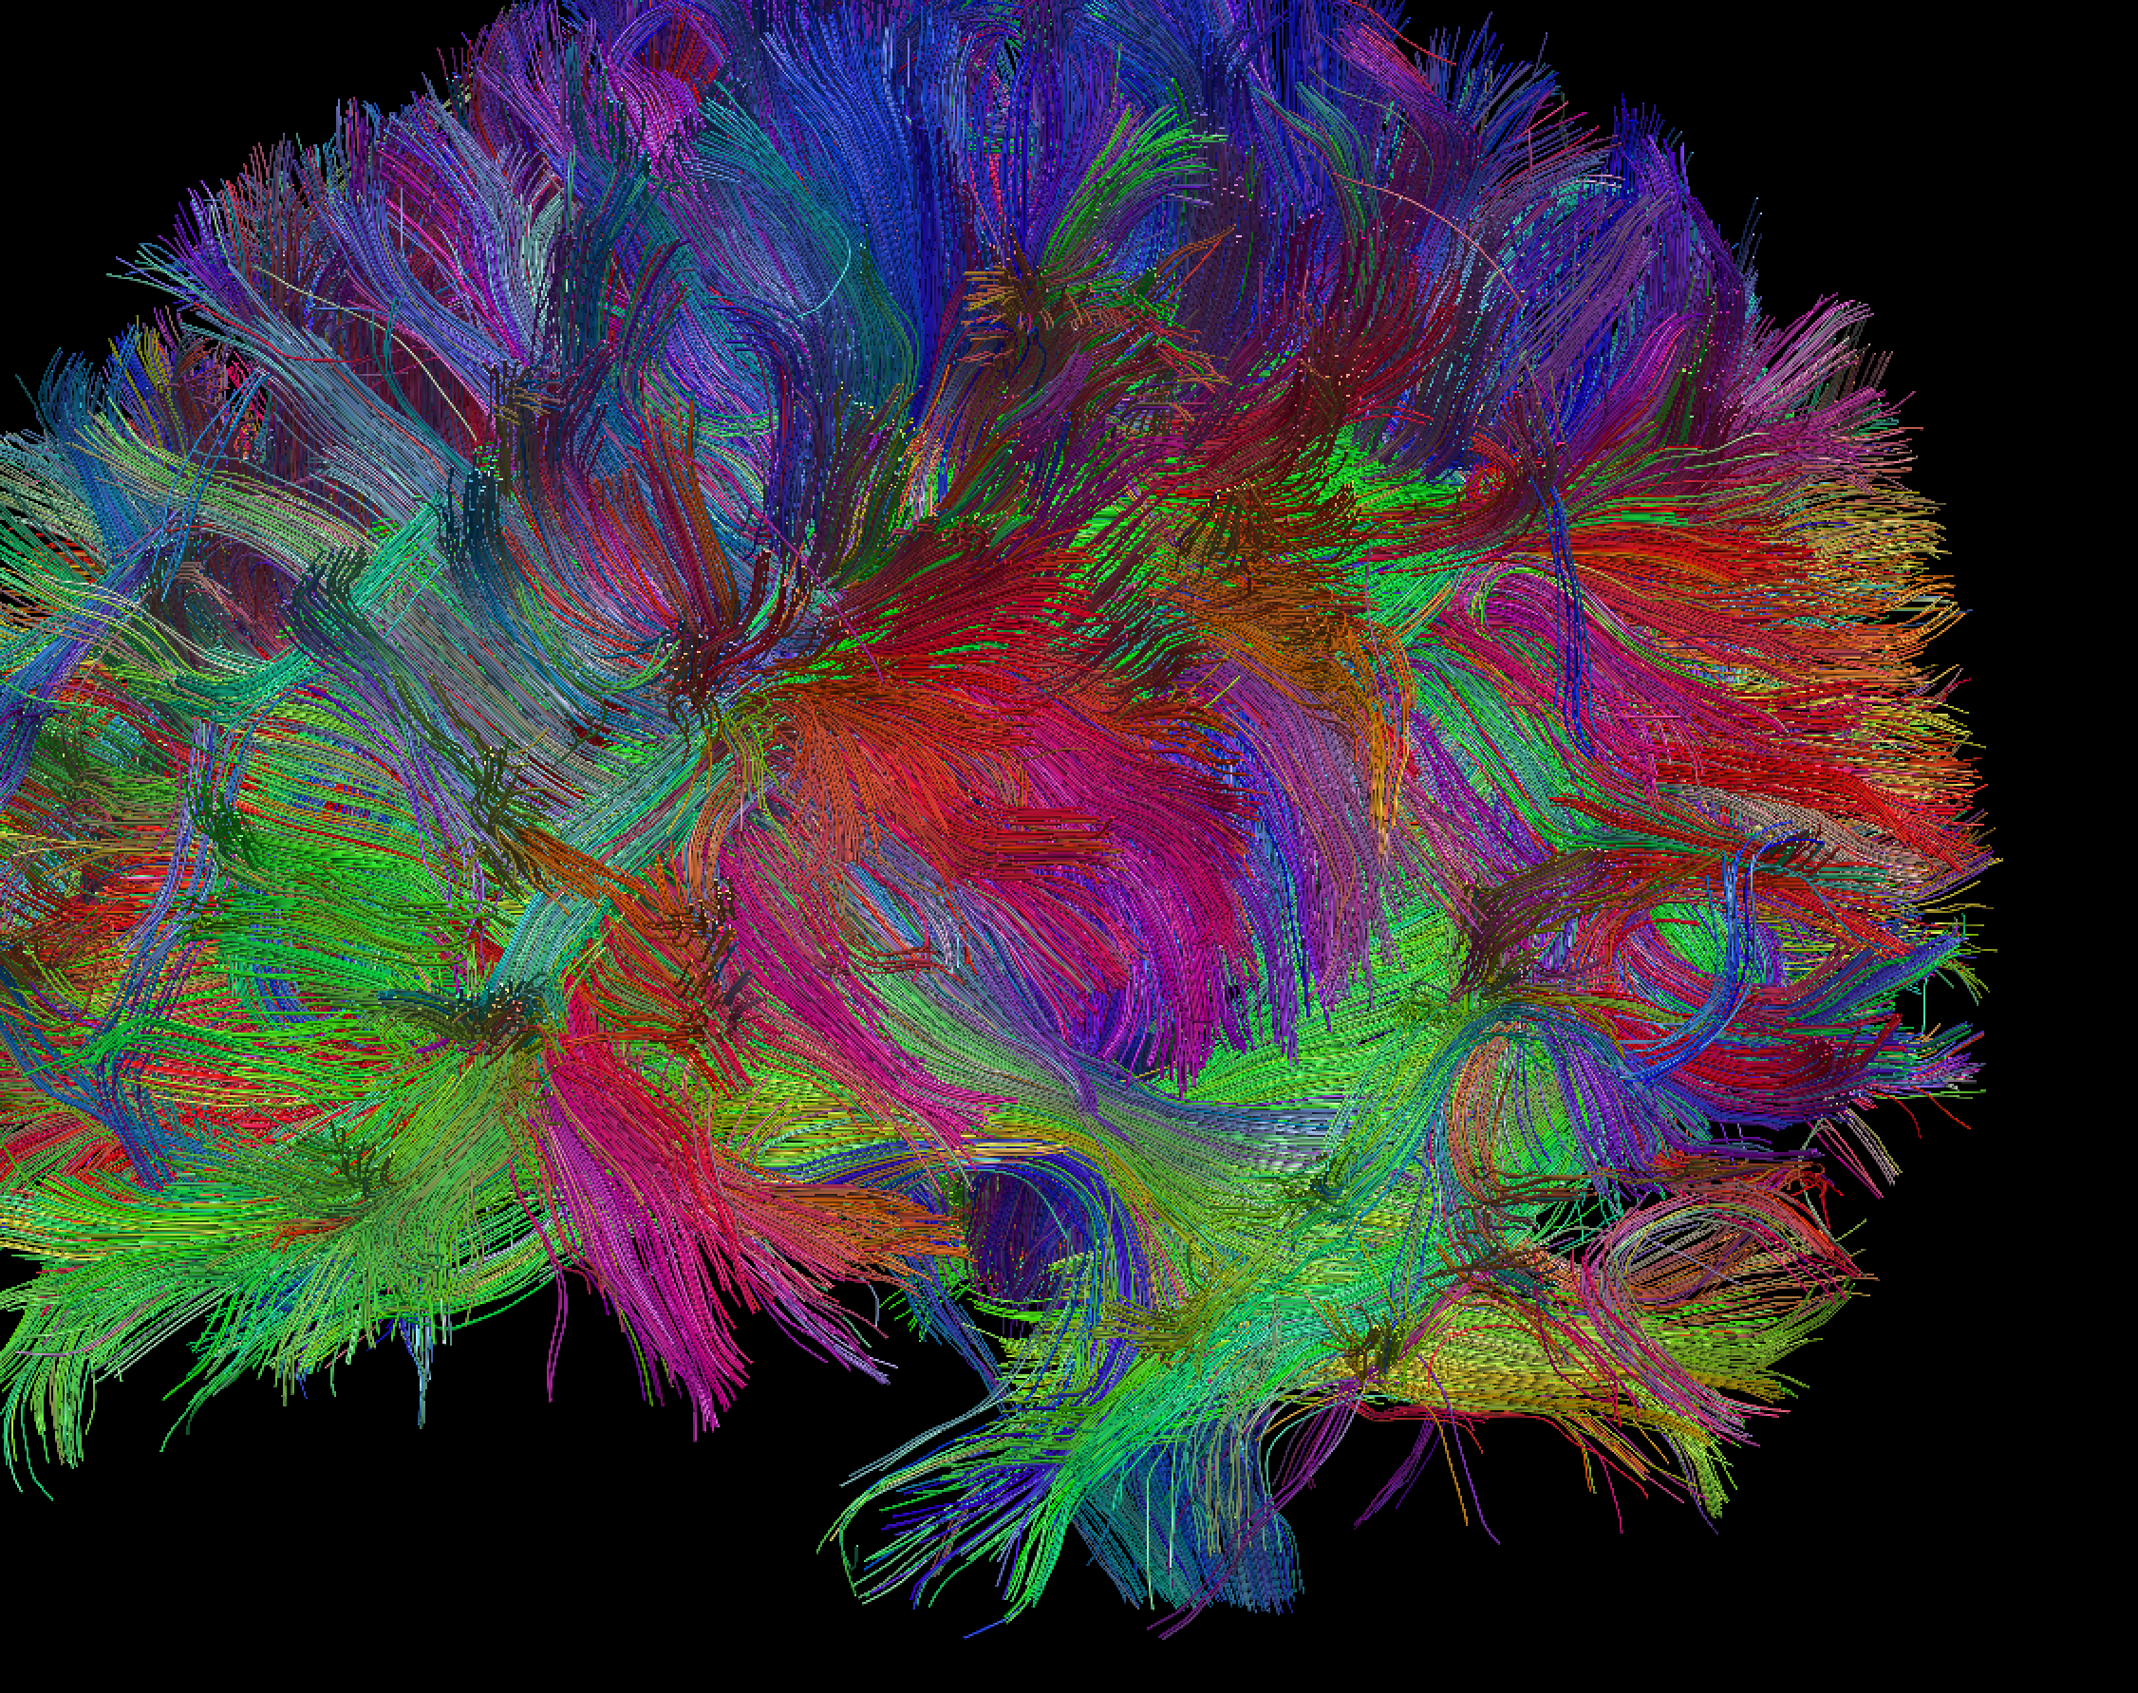
When we understand the biology and physiology of the body, and the biology of pain we can effectively treat CRPS.
But we must understand to role that the brain and nervous system play in pain.
Then we can have a better understanding on how to treat CRPS and take forward steps in finding a cure.

Slide 27
Traditional Treatments
Traditional / Conventional Treatment(s) include:
Rehabilitation - Physical and/or Occupational Therapy
Medications
Sympathetic or Stellate blocks
Spinal cord stimulation (SCS), Neurostimulation, and DRG stimulators
Nerve Ablation
Pain Pumps
Traditional treatments are simply treating the symptoms.
They are not getting to the source of the CRPS.
They are not addressing fight or flight.

Slide 28
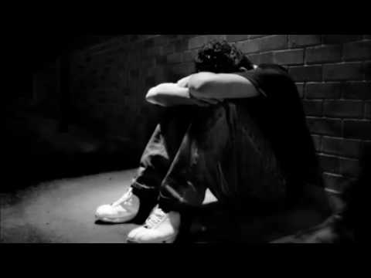
Pediatric Pain Programs
Their focus is to get your child more functional.
YES, this is important, but it is not addressing the cause of the CRPS.
Simply telling your child they have to learn to live with their pain and push through it – is NOT the answer!

Slide 29
Treating the Whole Person
A holistic approach to treating CRPS ultimately means treating the whole person.
This includes addressing:
Fight / Flight
The Vagus Nerve
Balancing the autonomic nervous system (ANS)
Breaking the pain loop
Addressing co-existing conditions
Reducing and controlling – stress, anxiety and depression
Increasing restorative sleep
Increasing overall sense of wellbeing
Providing you with the tools to live a fulfilled life.

Slide 30
What is the difference between traditional treatments, pediatric pain programs and a truly holistic approach?
Traditional treatments are simply treating the symptoms.
Pediatric Pain Programs
Their focus is to get your child more functional. Although this is very important – many pediatric patients leave these programs still living with high pain levels and dealing with trauma associated with the program(s).
Simply telling your child they have to learn to live with their pain and push through it – is NOT the answer.
A Holistic Approach
Holistic Centered Treatment (HCT)
Our program takes a whole-body approach - working with the biology and physiology of the body. This philosophy assists with systemic neural adaption, balancing the autonomic nervous system, and returning the body to homeostasis.
This is how the body can heal and your child can go from merely surviving to THRIVING.

Slide 31
Holistic Centered Treatment is redefining the healing experience through the integration of holistic modalities with cutting edge science. A 360° individualized approach to treating CRPS.
Think of it as a blueprint that can be customized to meet each patient’s specific needs and goals.
Our approach focuses on treating the whole person while also addressing co-existing conditions.
Helping your child to go from simply surviving to thriving!

Slide 32
We are as individualized as our fingerprint, and each person’s experience with CRPS is just as individualized. Therefore, to get the best outcome you must have a program or protocol that will be individualized to meet your child’s specific need and goals.

Slide 33
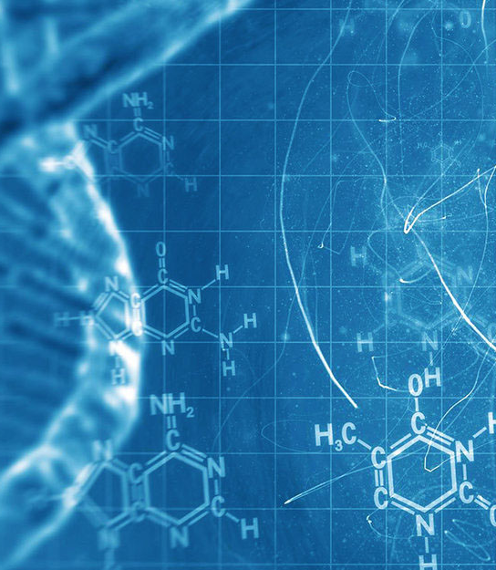
Our Blueprint
Our multi-modality protocol includes - Laser / Photobiomodulation, Pulsed Electromagnetic Field (PEMF), neuroplasticity training, biofeedback, neurofeedback, microcurrent, clinical hypnosis, breathwork, Neurosage, EMDR, etc.
Think of our multi-modality protocol as a blueprint that is individualized to meet your child’s specific needs and goals.
Unlike other programs – we can truly say we understand CRPS.
As someone that lived with type 2 CRPS for 7 years and gained long-term remission – I truly have walked a mile in the shoes of your child.
I believe that causing pain actually pushes the body further into fight/flight.
This is what makes us different and allows us to see remarkable changes in our patients.

Slide 34
The Bottom Line Is The Brain
It is responsible for all of the body's functions.
It controls body temperature, blood pressure, heart rate and breathing. It accepts a flood of information about the world around you from your various senses (seeing, hearing, smelling, tasting and touching).
Therefore, when the PERFECT STORM happens the brain responds to the storm. Sending out the wrong pain signals. The pain response - then triggers a stress response – which in turn causes the brain to release hormones, neuro-peptides and other neuro-hormones that effects other systems in the body.

Slide 35
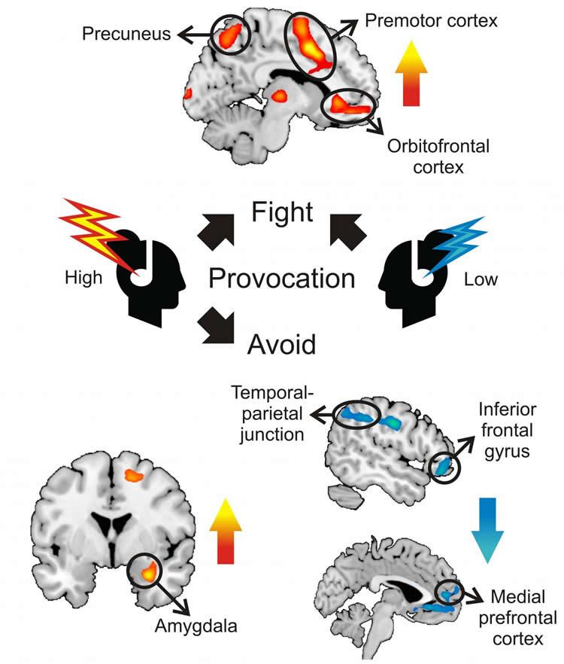
Stop the Fight or Flight Response
The first step to addressing CRPS is to address Fight or Flight.
When we can get the body out of Fight or Flight then we can calm down the sympathetic overload.
This allows us to start balance the autonomic system which plays a key role in our overall health.

Slide 36
Clinical Hypnosis
When we know the biology and physiology of the body, and the biology of pain we can effectively work to decrease pain and address fight or flight.
First and foremost – clinical hypnosis is NOT mind control. And it is NOT stating that your pain is made up. Quite the opposite.
Clinical hypnosis is the perfect tool. Our brain will not allow us to be relaxed and in fight or flight. It’s impossible. Thus, it is a great non-invasive and drug free tool to help our body get back into balance – homeostasis.
In the last 15 years, hypnosis for pain management has been exhaustively researched. With modern technology, MRIs, PET scans, etc., researchers have been able to prove that changes take place in the brain while under hypnosis. The evidence is compelling that hypnosis can be extremely successful in helping people reduce pain.

Slide 37
Vagus Nerve
The Vagus nerve is the 10th cranial nerve, and it is extremely important.
It controls inflammation of the body (including nerves), GI function and immune function, to name a few.
The autonomic nervous system (the automatic nervous system) is divided into two parts:
- Sympathetic (fight or flight)
- Parasympathetic (rest and digest)
The Vagus nerve contains parasympathetic fibers. So, when we stimulate the vagus nerve not only are we helping to release endorphins, serotonin and melatonin, but we are also helping to balance out the autonomic system.

Slide 38
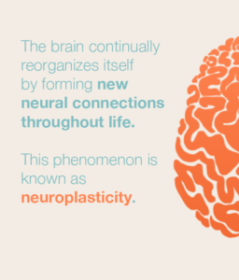
Neuroplasticity Training
Neuroplasticity, also known as brain plasticity and neural plasticity, is the ability of the brain to change throughout an individual's life.
Working with neuroplasticity is another key to helping CRPS patients regain their lives.

Slide 39
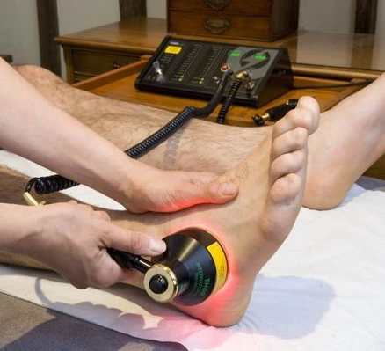
Laser Photobiomodulation
Laser and LED beams of light can stimulate the cells in the body that repair tissue, reduce inflammation and transmit pain.
RESULTS
Significant reduction of inflammation equal to or better than NSAIDs within 2 hours, analgesic effects that last for 48 hours.
Thus, increasing healing time of chronic tendinopathies by up to 70%.

Slide 40
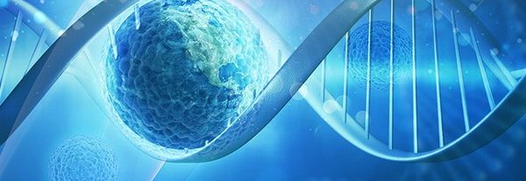
Pulsed Electromagnetic Field (PEMF)
PEMF therapy slows or stops the release of pain and inflammatory mediators, increases blood flow of the cells, and re-establishes normal cell interaction. Which can reduce inflammation, decreases pain, energy increases, and it promotes faster tissue healing.

Slide 41
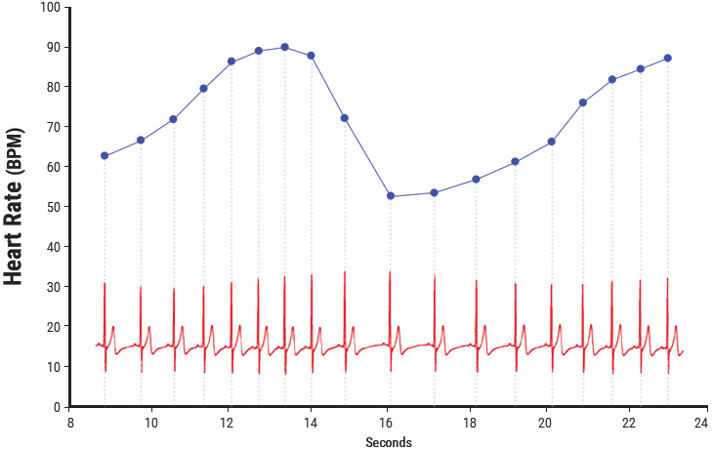
Heart Rate Variability (HRV) The Heart–Brain Connection
The function of the sympathetic and parasympathetic nervous systems is involved in pain regulation.
It is also recognized that the changes in autonomic balance which are associated with chronic pain can be assessed by HRV.
When our pain goes up it had a direct effect on our heartrate.
Increase in stress and anxiety also have a direct effect.
Therefore, by working with HRV through biofeedback we can make adjustment to hone in our HRV.
Thus, having a positive effect on the ANS.

Slide 42
Eye Movement Desensitization and Reprocessing (EMDR)
EMDR therapy shows the mind can in fact heal from trauma much as the body recovers from physical trauma.
When you cut your hand, your body works to close the wound. If a foreign object or repeat injury irritates the wound, it festers and causes pain. Once the irritant is removed, healing resumes.
EMDR therapy demonstrates that a similar sequence of events occur with the mental process.
The brain's information processing system naturally moves toward mental health. If the system is blocked or imbalanced by the impact of a disturbing event, the emotional wound festers and can cause intense suffering.
Once the block is removed, healing resumes.

Slide 43
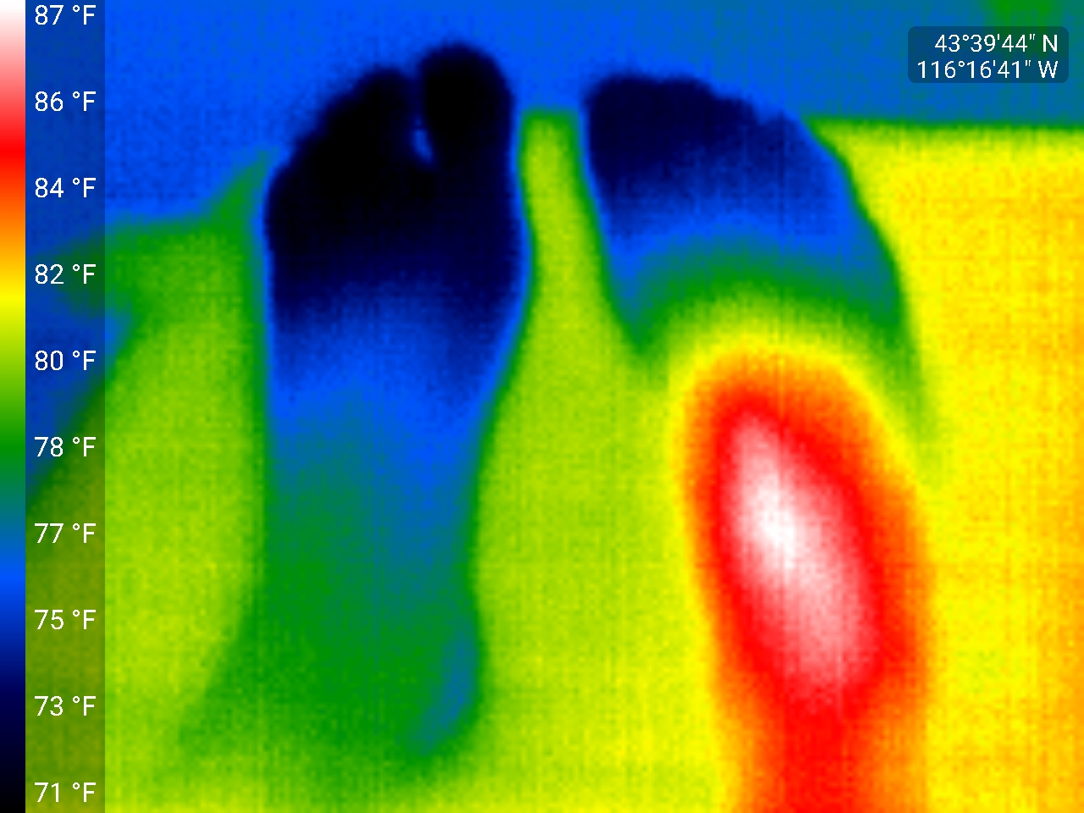
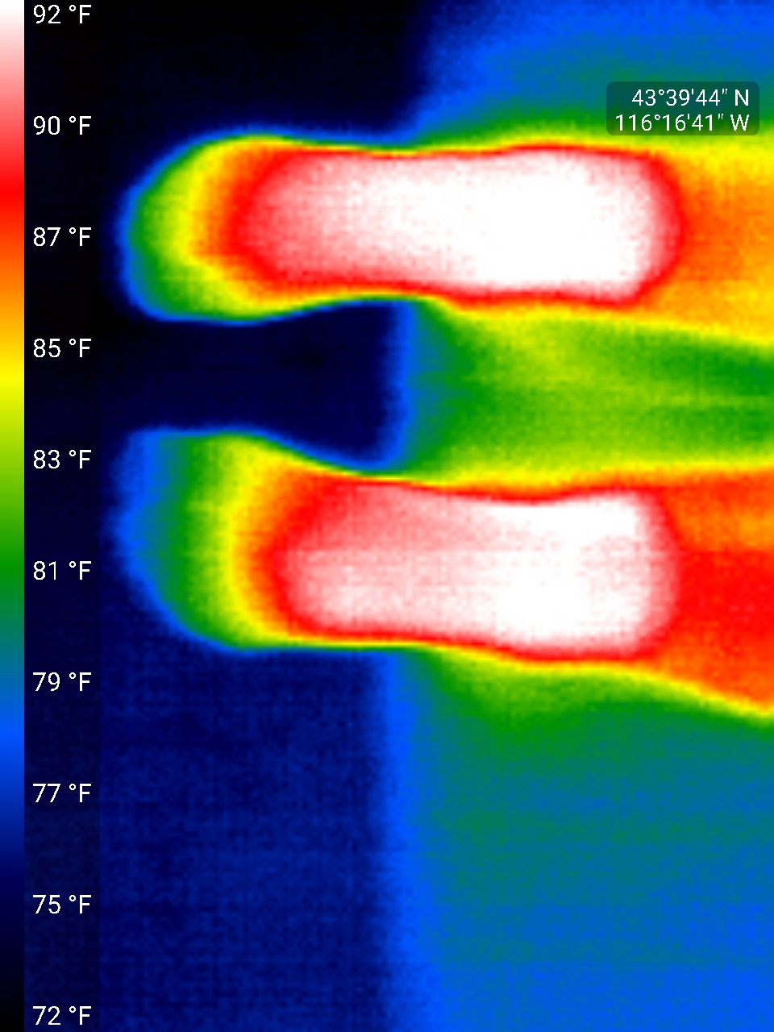
Thermography
Thermography or a thermographic image allows us to see temperature changes associated with CRPS. As we balance the ANS we typically see the temperature regulating too. This is the perfect example.

Slide 44
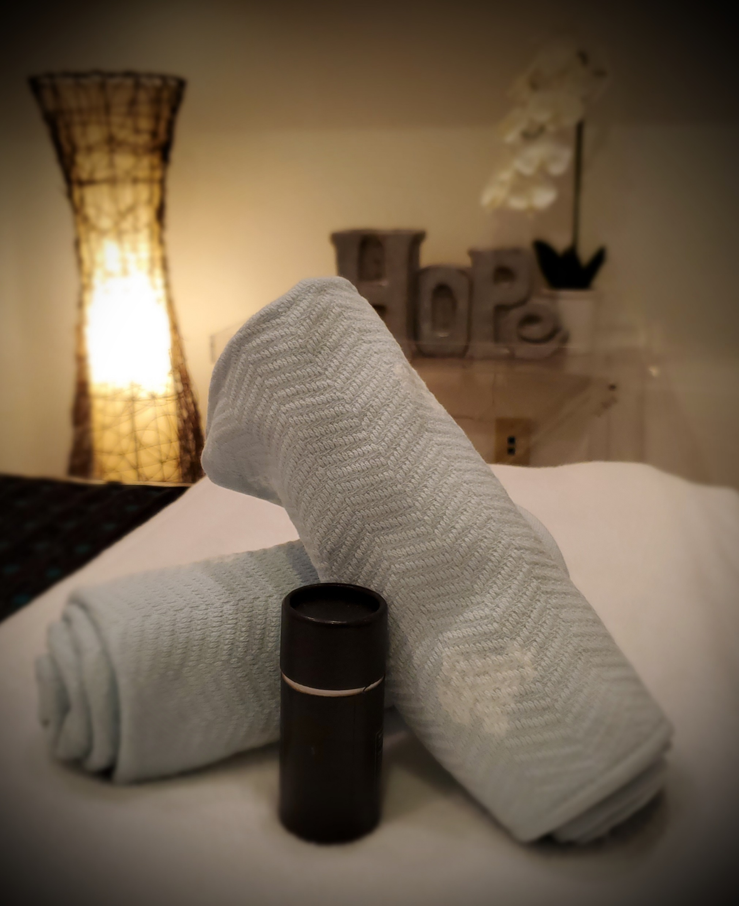
Two Week Intensive Followed By A 90-Day Home Program
Our HCT Intensive is a two (2) week outpatient program located in the Treasure Valley (near Boise, Idaho).
Our multi-modality program is individualized to meet your child's specific needs and goals.
Then you're sent home with a 90-day home program.
During your 90-day home program we will encourage PT and/or OT to increase your strength, stamina and range of motions (if needed). You will also be given tools that will help you have long-term outcomes.
We don’t believe it is necessary to be away from home for months on end.
Our goal is to help your child regain their life and to provide the tools for them to return to school, return to sports and live a full and productive life!

Slide 45
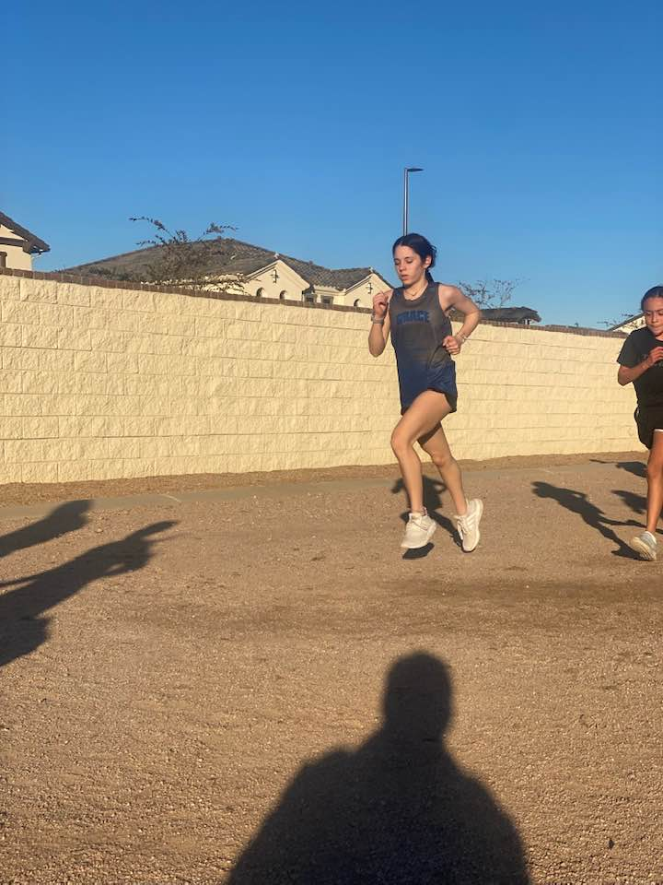
13-year-old diagnosed with CRPS in her right lower leg and foot.
Onset: Sept. 2019. She tried and failed the following treatments:
Sympathetic Blocks, PT, OT, Chiropractic, Medication, LLLT, Kinesiology, Acupuncture, Massage, and an outpatient pediatric pain program.
Upon arriving she placed her pain at 5/10 and it had gotten to a 8/10 in the past 24 hours.
Her goals: 2-3/10 pain, take a bath or shower without pain, chase dog around the yard, play on trampoline, sleep, hang out with friends, roller skating, playing sports, gymnastics, and possibly getting involved in track.
Following her 2-week Intensive she placed her pain a 0.5/10.
She is now approximately 3 months out and is at a zero-pain level and in remission. She is in school, running track and returning to competitive gymnastics.

Slide 46
15-year-old female diagnosed with CRPS. Her pain started the summer of 2013, but she was not diagnosed until Jan. 2017.
She had done a multitude of different treatments including:
A 1-year outpatient program at Randall Children’s Hospital that included extensive PT & OT. Even at the conclusion of that program she was only able to drop her pain levels to 2/10.
Since Dec. 2021 she had been in a flare that had pushed her pain to 9-10/10. She was not sleeping well, had little appetite and was struggling.
Her goal was to get back to a normal life, to be able to show her horse, put on shoes, etc.
She started at 9/10 on pain scale overall. Her CRPS affected her hands and left foot/ankle.
At the conclusion of her Intensive she was at a zero-pain level and was able to put on shoes. She is approximately 1-month out from her Intensive. She is riding and showing her horse and is back to normal activities.

Slide 47
And with me today is Ruthie to share their family’s experience. I treated her daughter a year ago following a diagnosis of CRPS.
9-year-old female diagnosed with CRPS.
We did a one week Intensive. During that time, she was able to drop her pain levels from 10/10 to a 6/10.
Then utilizing her 90-day home program coupled with a few Telehealth appointments she was able to get down to a 0/10 – remission.

Slide 48
Holistic Centered Treatment
A HOLISTIC APPROACH TO
HEALING AND HOPE
An individualized approach
Treating your child as a whole – not just the symptoms
Non-Invasive & Drug Free protocol
A compassionate and healing environment
Created by someone that actually lived with CRPS and understands what your child is going through!
Our program addresses all aspects of CRPS
Physically
Mentally
Emotionally
Spiritually
www.HolisticCenteredTreatment.com | 844-994-0999

Slide 49
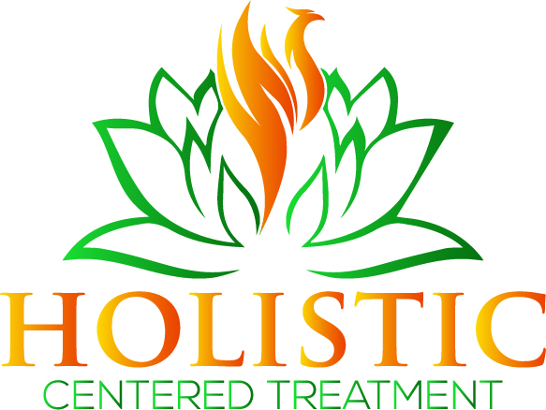
Holistic Centered Treatment
Providing Hope and Help to those diagnosed with CRPS.
844-994-0999
www.HolisticCenteredTreatment.com
Info@HolisticCenterredTreatment.com
Our message is simple: Patients with CRPS do not have to suffer—not in silence and not through cries of agony. Traditional allopathic medicine may not have all the answers, but when we combine evidence-based treatments with the latest science and technology then we can help patients regain function and regain their lives. This happens when we address all aspects of diagnoses and how it affects you – physically, mentally, emotionally, and spiritually.

