Slide 1
Navigating Through Physical Therapy
Anita L. Davis PT, DPT
Ruth Hooten, CRPS Warrior

Slide 2
Finding a Therapist*
Clinical skills
Knowledge
Interest
Skill
People skills
Openness
Compassion
Availability
Flexibility
Notes:
RUTH Questions to ask: Is there a therapist in your office that has treated someone with CRPS. Is there a therapist in you office that has treated someone with chronic pain. Can I speak to the therapist before my first visit. What kinds of treatments would you suggest for someone with CRPS. What outcomes do your patients tend to have after treatment.

Slide 3
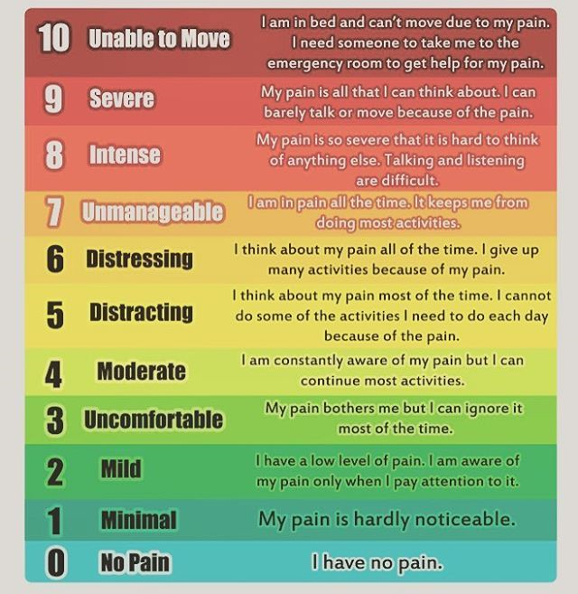
Communication*
Pain levels
Pain level correlating to activity
Baseline for improvement
Guideline for therapy

Slide 4
Communication*
Activity options
Shared decision making
What does the treatment involve
Who has this worked well for
Side effects
What’s the benefit

Slide 5
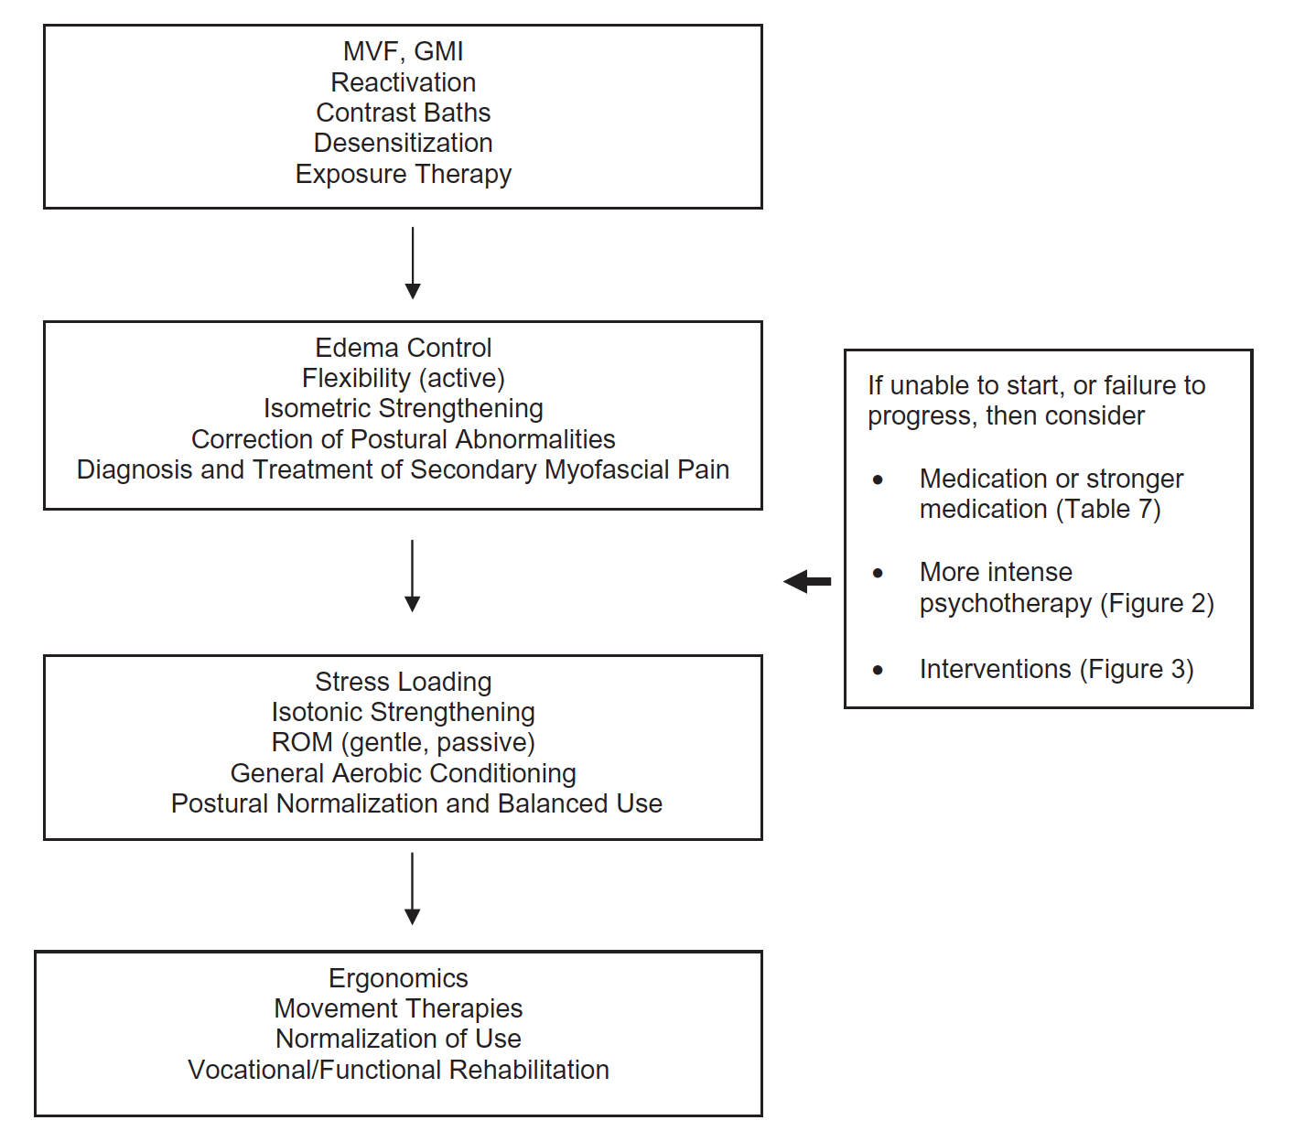
Rehabilitation Progression
Harden et al. Pain Med 2013;14(2):180-229.

Slide 6
Desensitization*
Pressure
Texture
Temps
M’vmnt

Slide 7
Mirrors*
Graded motor imagery
Lateral recognition
Imagined movement
Mirror movement
Visualize healthy limb performing movement in a mirror
Mirror therapy
Visualize healthy limb performing movement in a mirror

Slide 8
Other Options
Warm water exercise
Functional tasks
Aerobic exercise
Carry
Loading
Balance

Slide 9
Ek & Gijn, 2009
Pain Exposure
102 patients, 4.5yr duration
Treatment 5 sessions over 3 months
Education regarding false pain
Functional activity and mobility
Full functional recovery in 49 patients
Pain reduction in 76 patients

Slide 10
De Jong, 2005
Graded Exposure in Vivo
8 patients, 3 yr duration
Treatment x10 weeks, BIW
Education regarding fear avoidance
Functional activity and exposure
Increased function by 50%
Decreased fear from 80th to 10th percentile
Decreased symptoms and pain

Slide 12
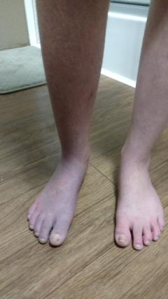
Teens and Younger
Medication
Physical therapy
Range of motion
Desensitization
Gait training
Games
Sympathetic block

Slide 14
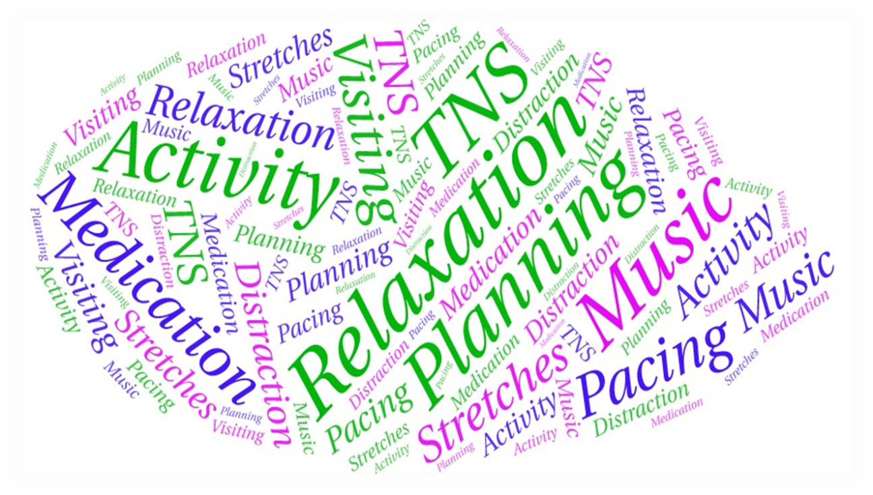
Flare-up Management*
Things to Adjust
Behavior
Thoughts
Environment

Slide 15
Flare Management*
Things to Adjust
Behavior
Thoughts
Environment

Slide 16
Flare Management*
Things to Adjust
Behavior
Thoughts
Environment

Slide 17
Strategies for Success
Perform
Pace
Plan

